Slide 1
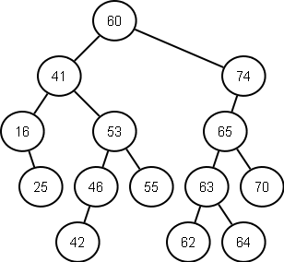
Binary Search Trees
Should be a review

Slide 2
Binary Search Tree
Definitions:
  Vertex:
  Edge:
  Parent:
  Grandparent:
  Uncle:
Let’s draw a few trees and discuss what each of these items are

Slide 3
Binary Search Tree (Insertion)
If current node empty/NULL add node
Else if insert value less than current node insert left
Else if insert value greater than current node insert right
Else replace value
Recursion (elegant, but can be costly – why?)
What does an iterative insert look like?
What is worst case and average case?

Slide 4
Binary Search Tree (Lookup)
If current node equals search value return node
Else if current node greater than search value search left
Else if current node less than search value search right
Recursion
What does an iterative insert look like?
What is worst case and average case?

Slide 5
Binary Search Tree (Deletion)
Find node with delete value
If no children just delete
If one child; promote child
If two children
  Find in-order successor/predecessor of node
  Replace node contents with successor/predecessor
  Delete successor/predecessor (may have at most one child)
Recursion
What does an iterative insert look like?
What is worst case and average case?

Slide 6
Binary Search Tree (Traversals)
Pre order - NLR
In order - LNR
Post order – LRN
Very elegant when recursive
These may actually be more efficient implemented recursively
What would iterative solutions look like?

Slide 7
Rotations (Right)
Is the order of the tree preserved?
Why would we do this?
=>
52
37
37
31
52
96
31
49
49
96

Slide 8
Rotations (Left)
=>
37
52
31
52
37
96
49
96
31
49

Slide 9
Rotations (Right)
Does this make the value more clear?
When does a tree have “worst case”
=>
52
37
37
31
52
31

Slide 10
Rotations Question
What about this one? Can you rotate it to a depth of 2? How?
52
=> ?
37
49

